Slide 1

Group Members:
Santosha Nagaratnakar
Deepak Kumar

Slide 2
Work Flow
An interactive website that enables users to order a variety of grocery items online and have them delivered to their doorstep.
The vendor lists his products on the website in order to sell them.
Customers browse the products and place their orders.
Paying bill using a credit or debit card.

Slide 3
Technologies Used
HTML
CSS
Javascript
MongoDB
Express
React, Redux
Node
RestAPI
Bootstrap

Slide 4
API Integrated
Stripe API
Used for Payment Processing
Cloudinary
Used for storing images in cloud.

Slide 5
Users
Login/Register
Browse Products
View Products Price, details
Order Products
Place an order
View order history
View the cart and remove from the cart
Make Payment
Update Password

Slide 6
Admin
Login
Create Products
Delete products
Read product Details
Read Users Details
See Order Details
Process the Orders

Slide 7

Home Page

Slide 8
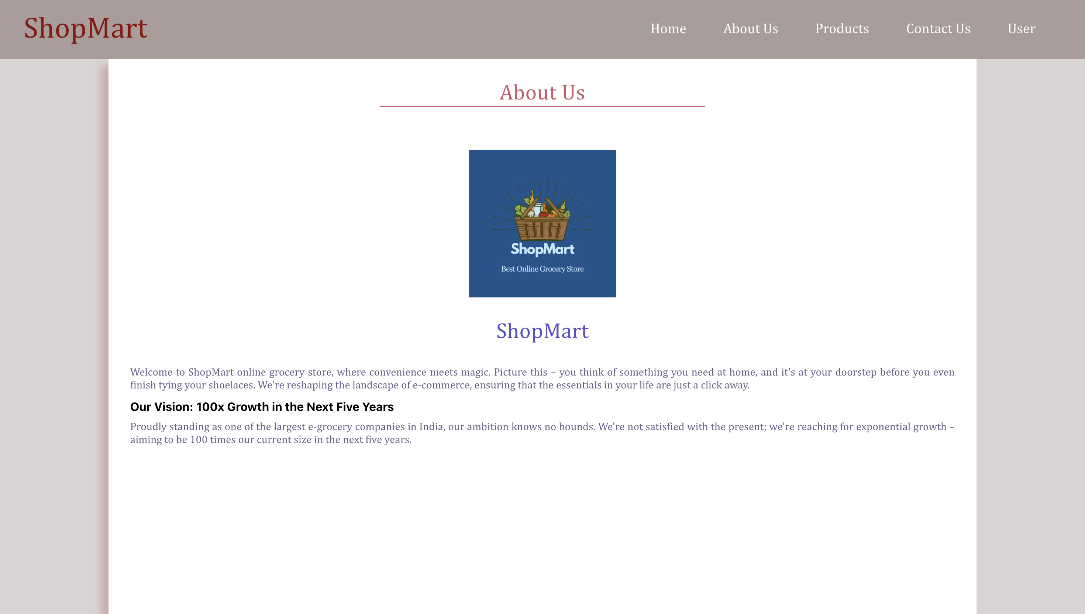
About Us

Slide 9
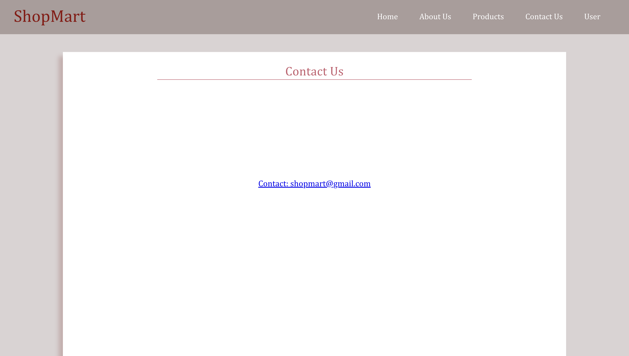
Contact Page

Slide 10
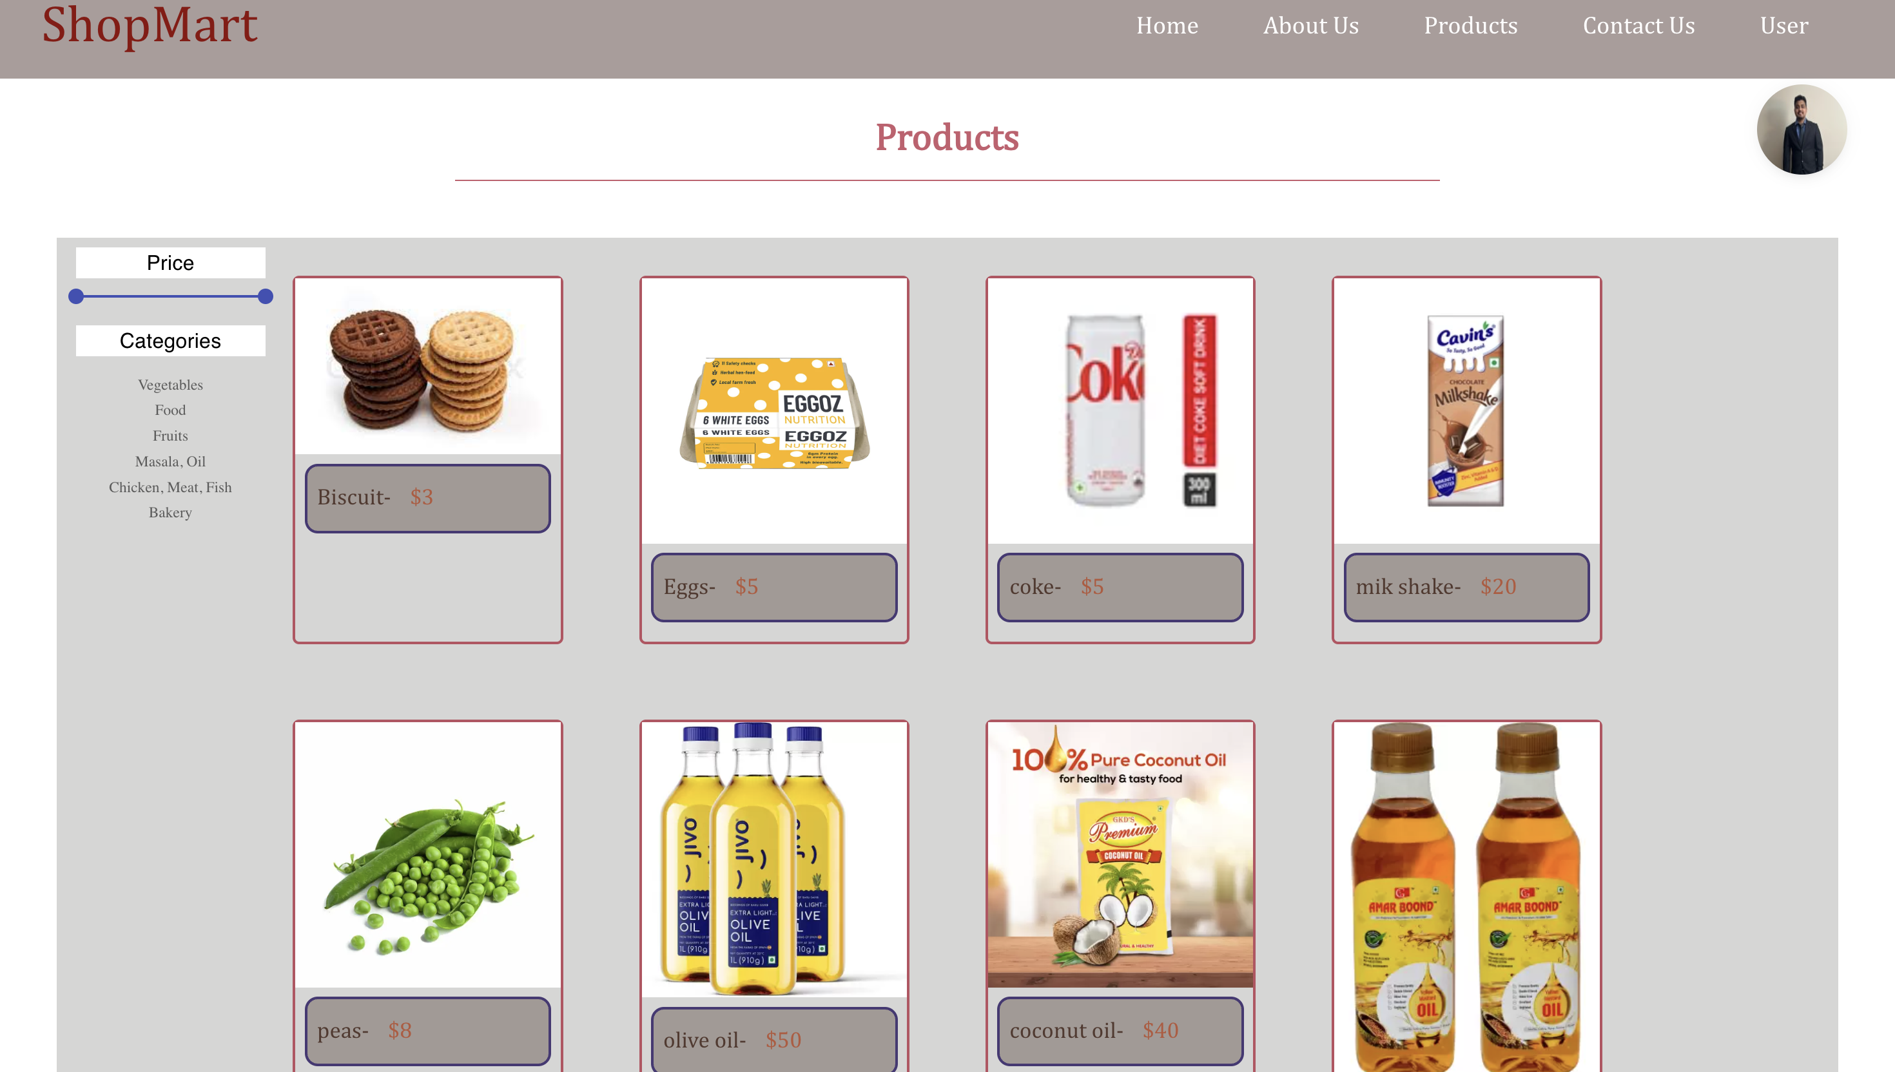
Products Page

Slide 11
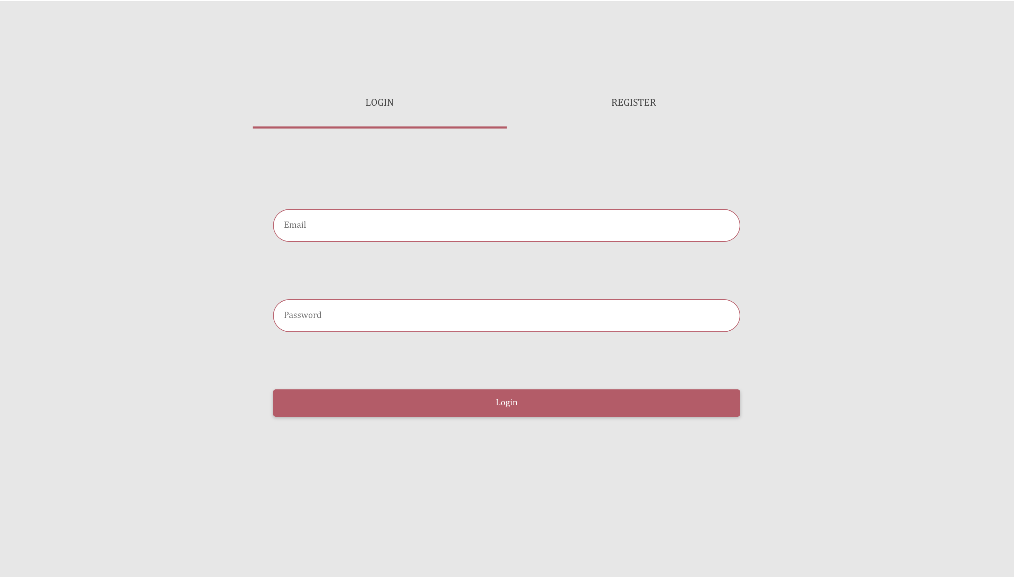
Login Page

Slide 12
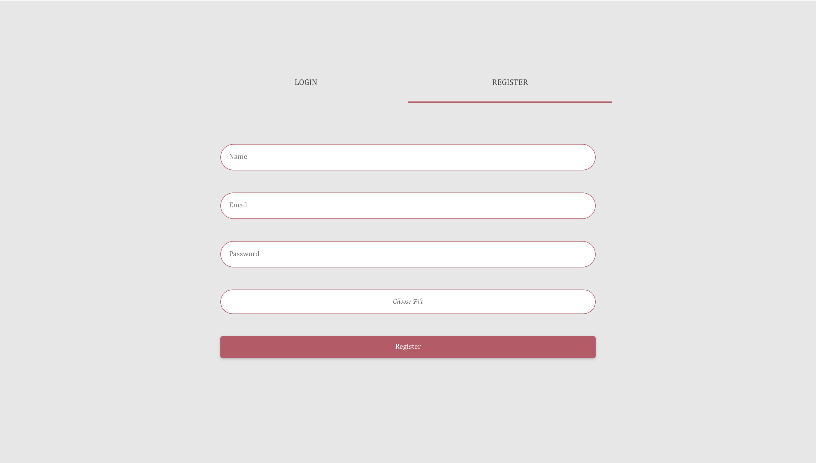
Registration Page

Slide 13
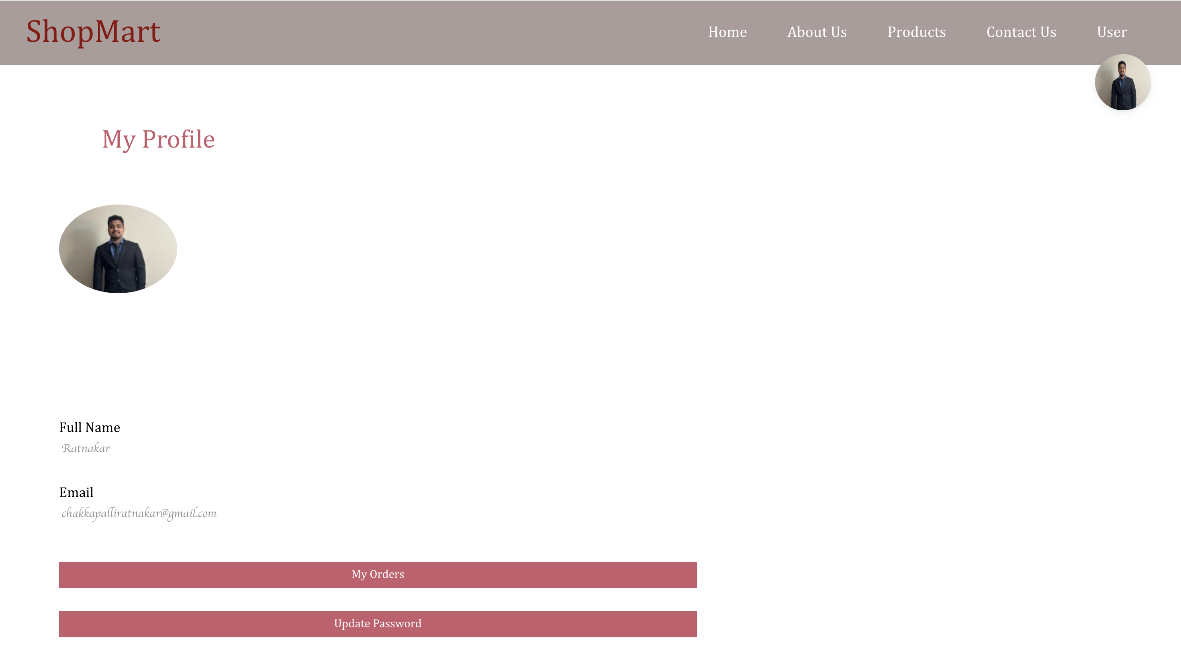
Profile Page

Slide 14
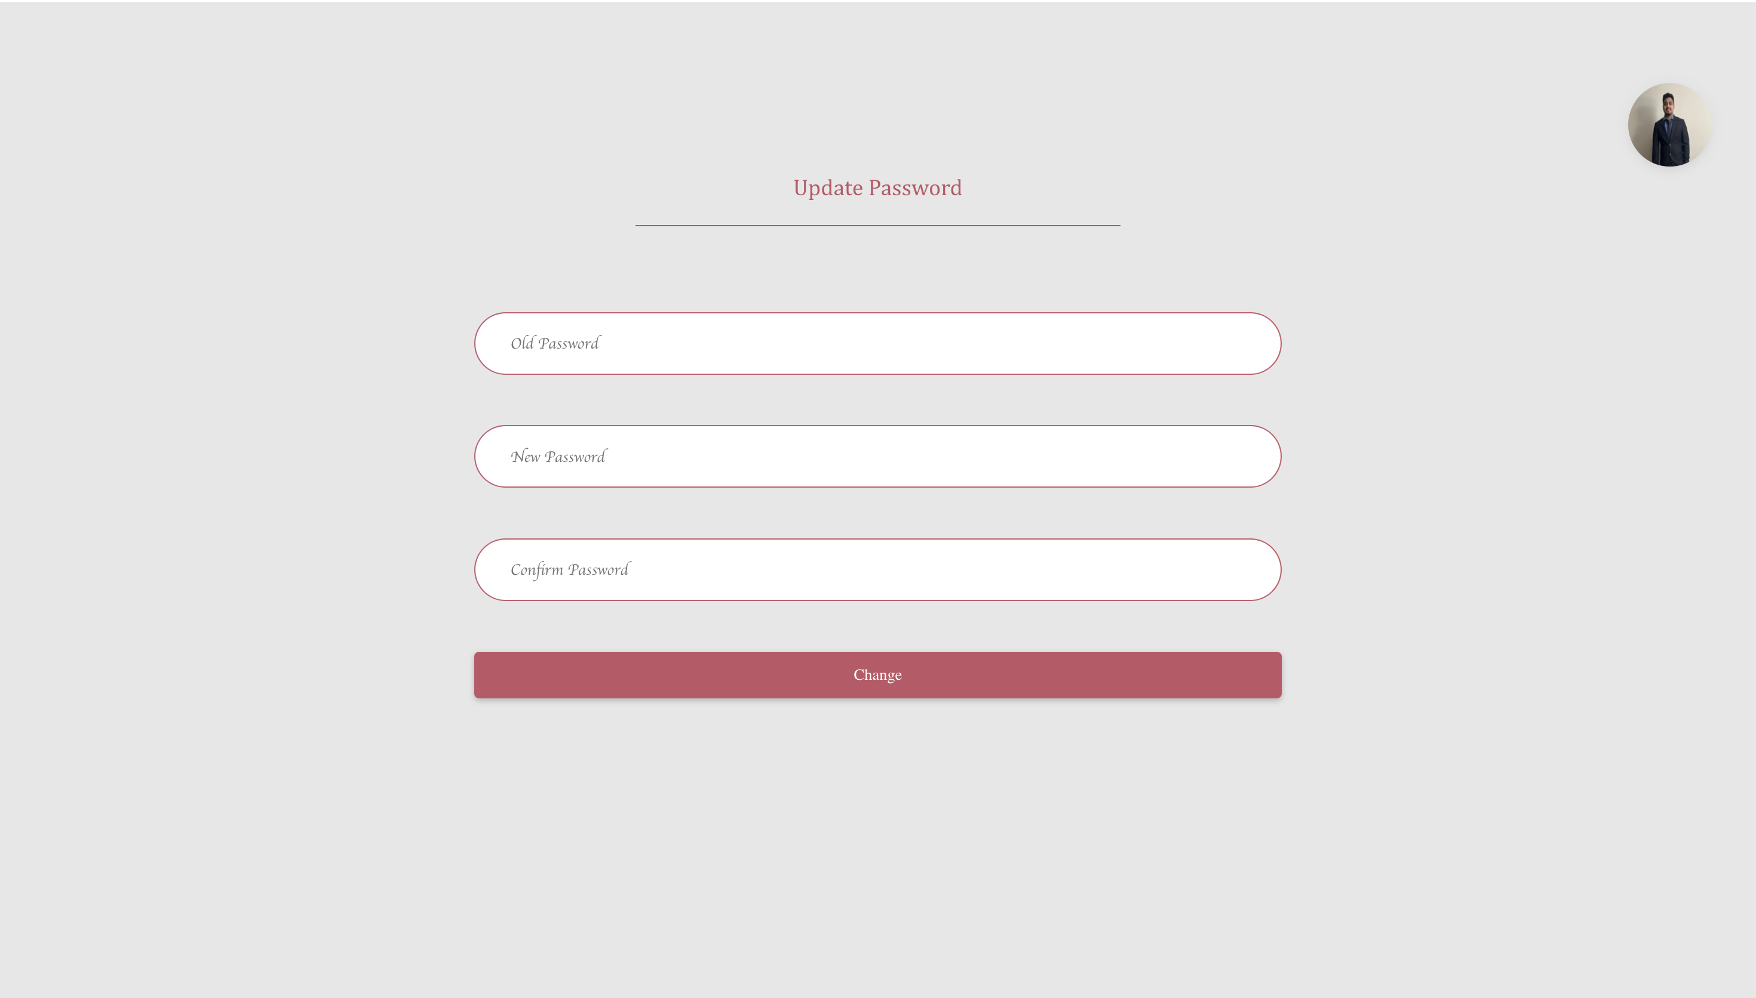
Update Password Page

Slide 15
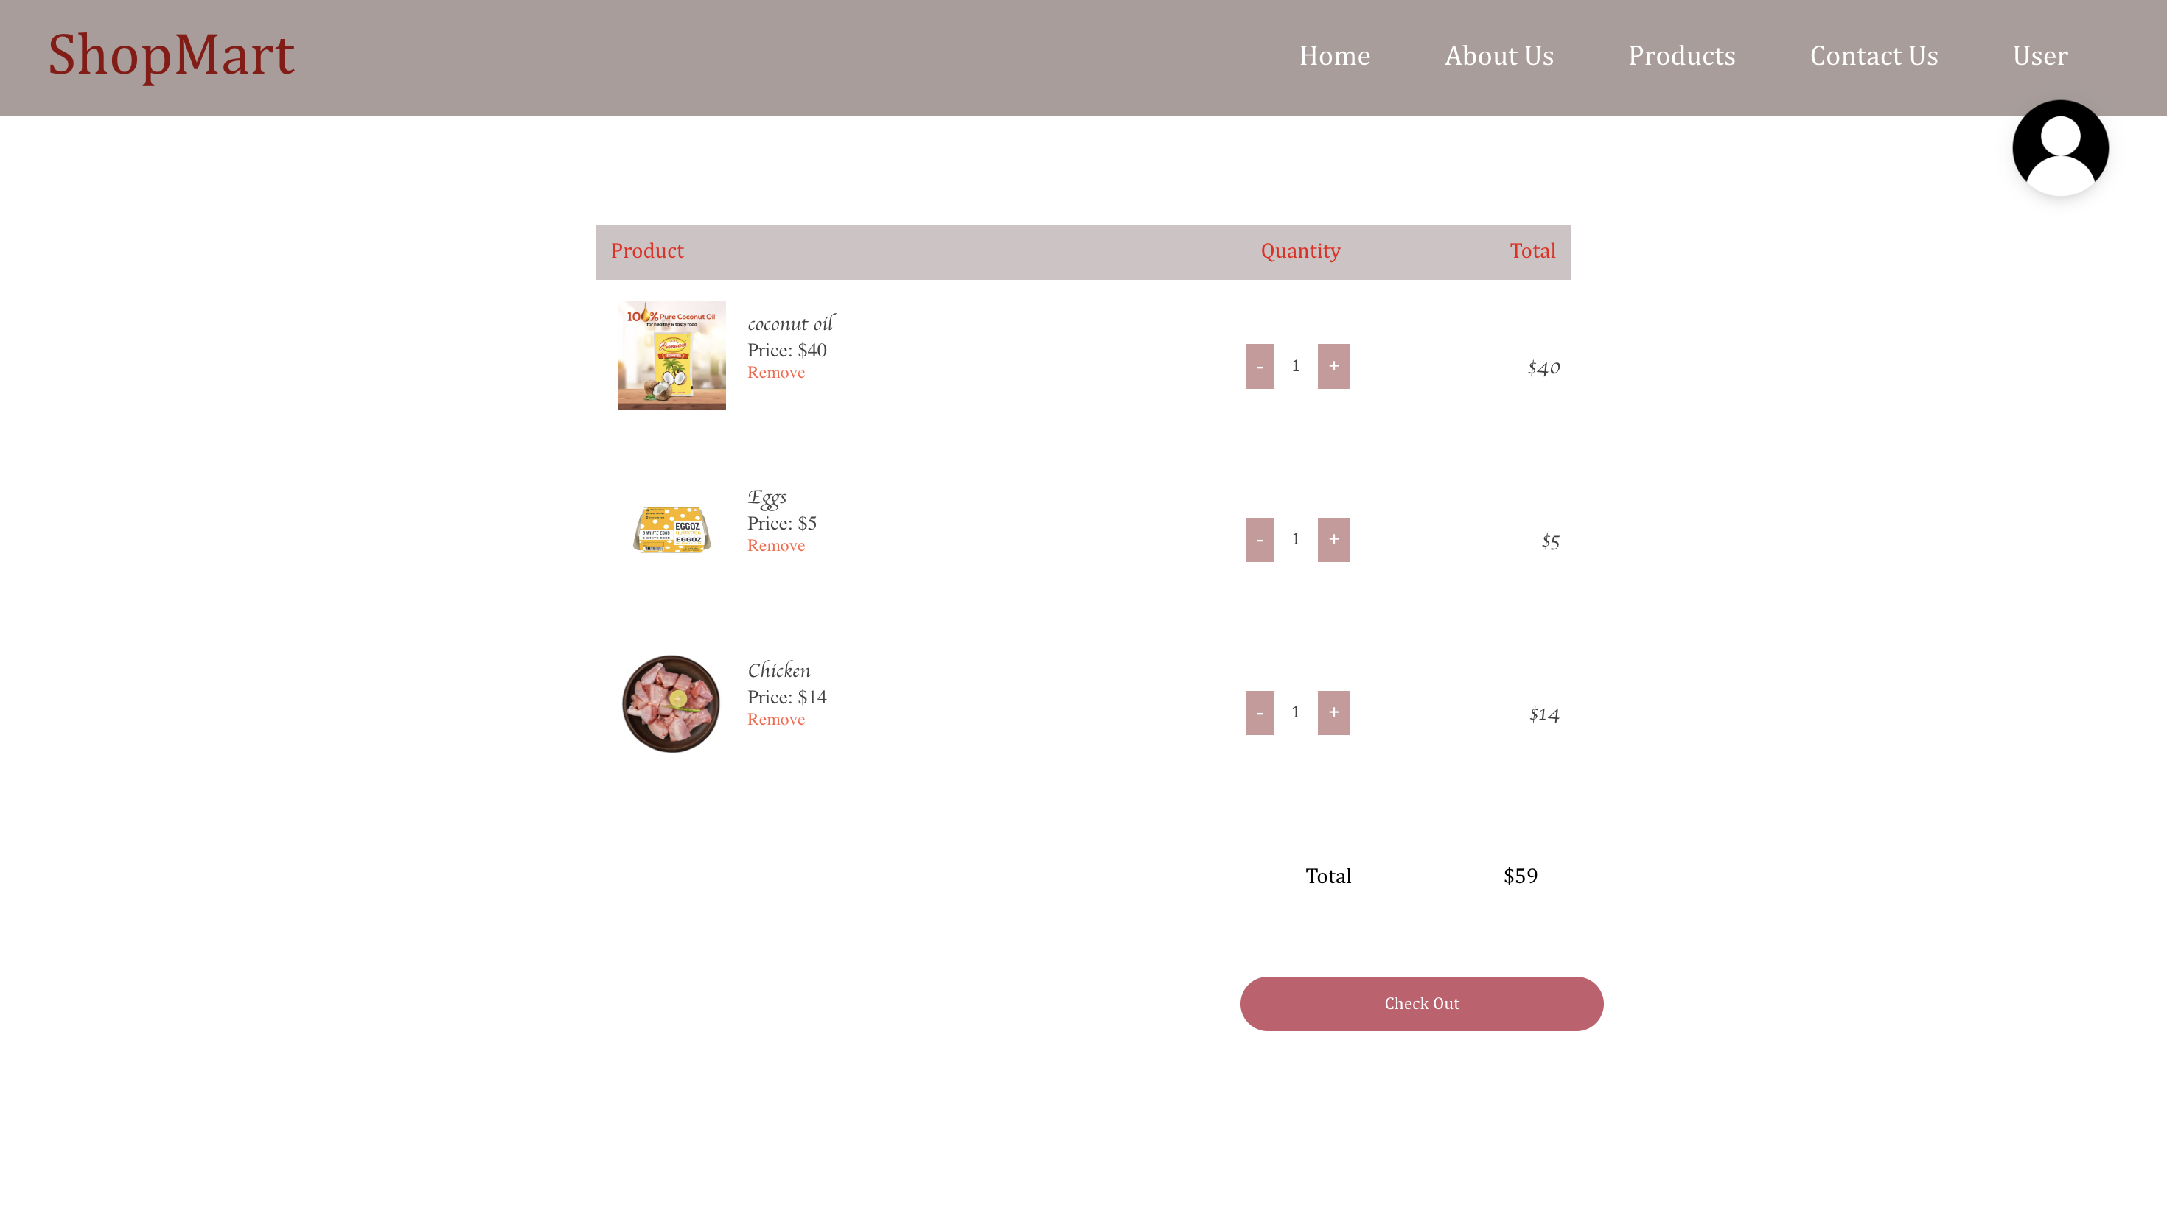
My Cart Page

Slide 16
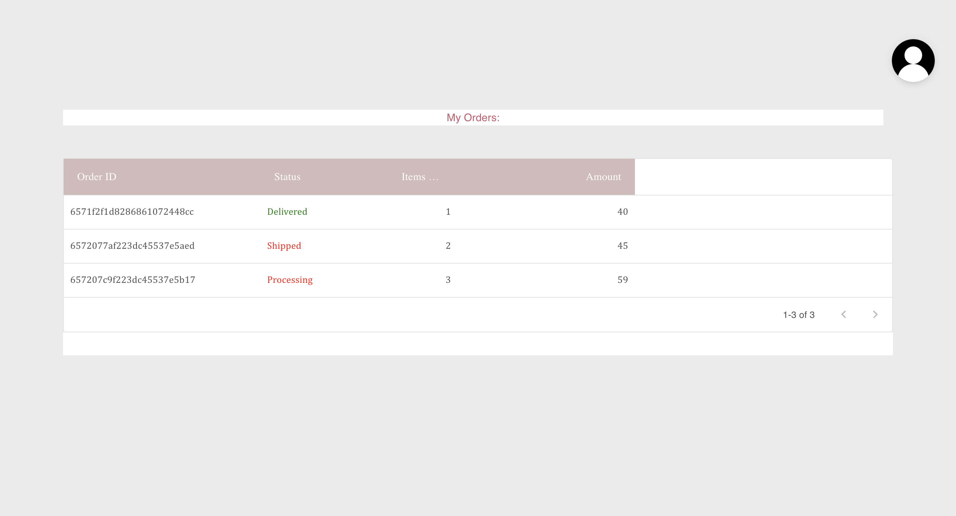
My Orders Page

Slide 17
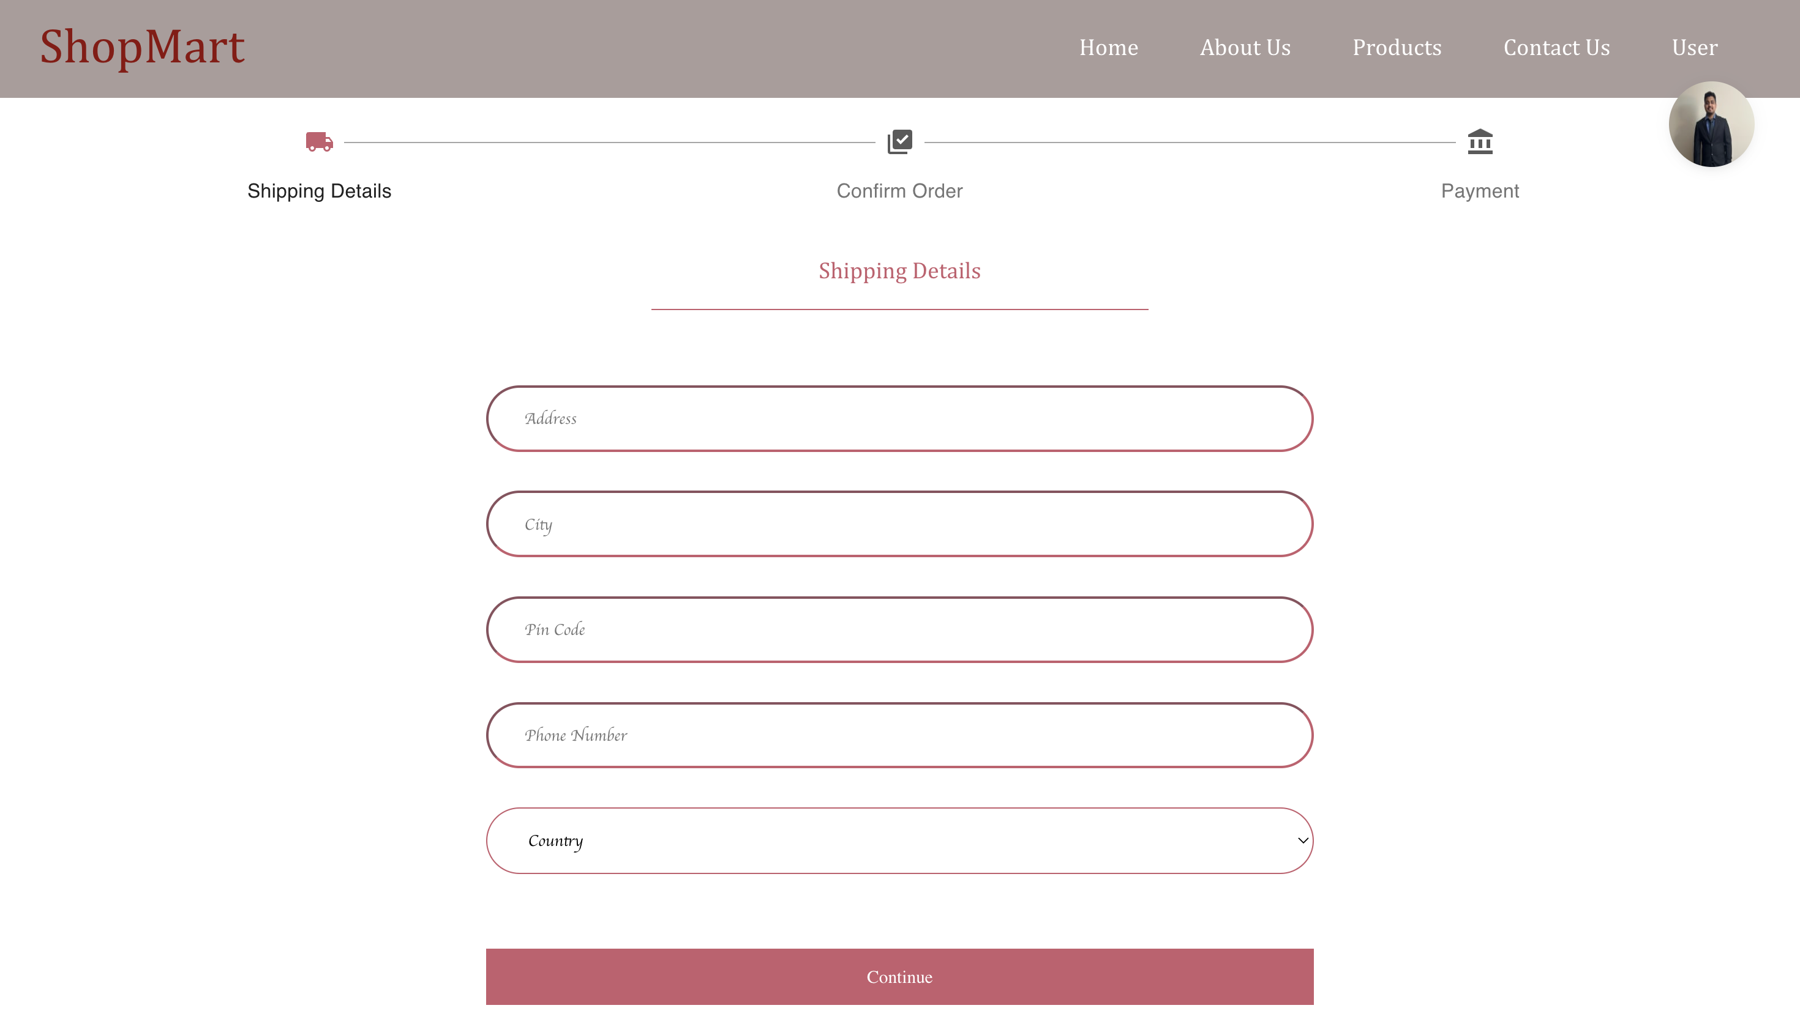
Shipping Address Page

Slide 18
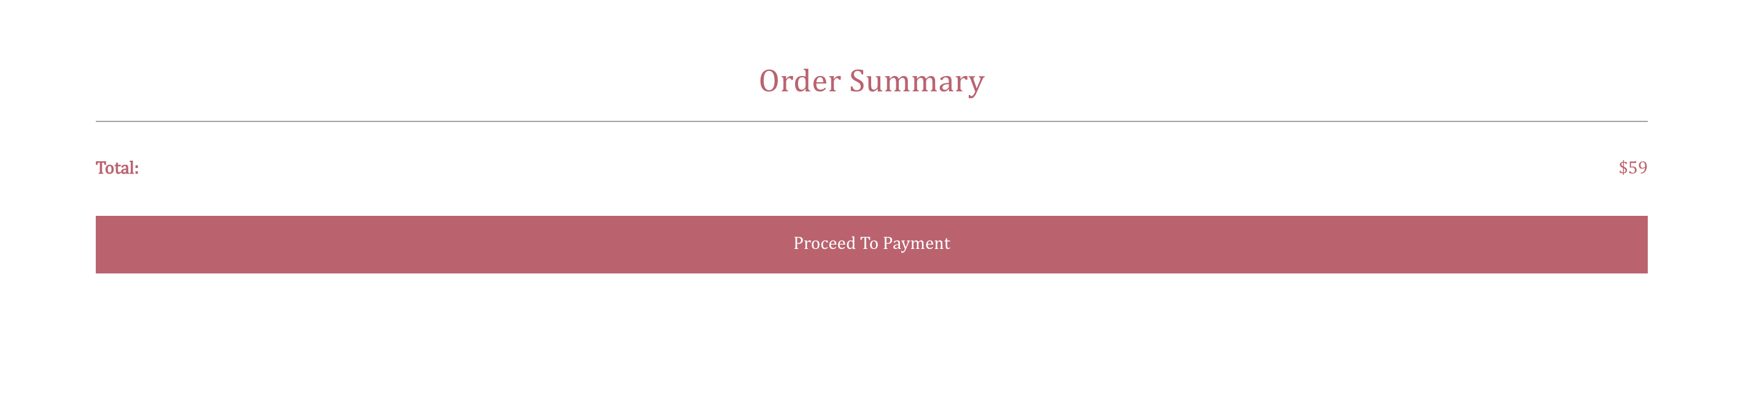
Order Summary Page

Slide 19
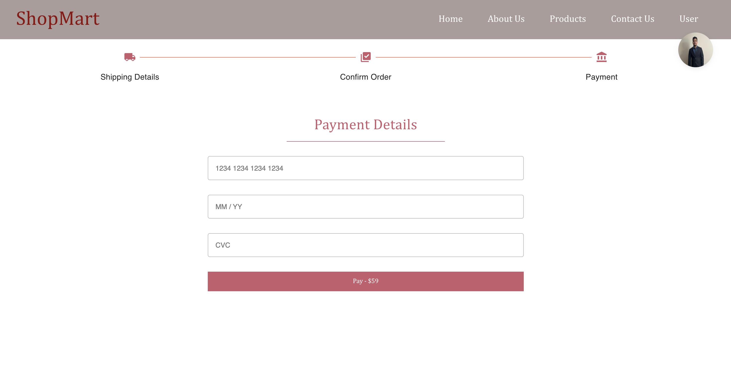
Payment Details Page

Slide 20
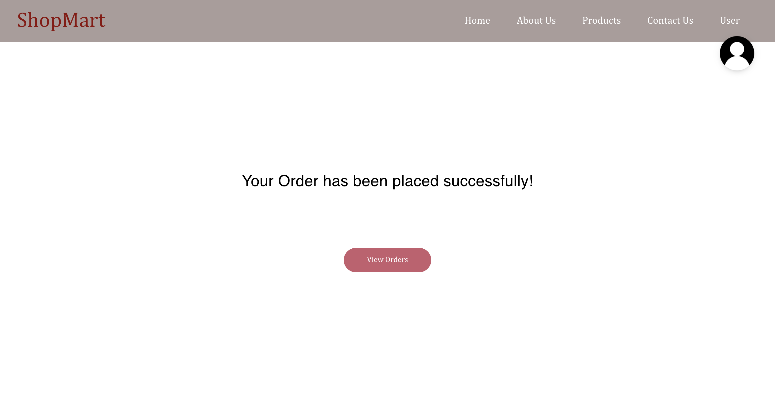
Order success Page

Slide 21
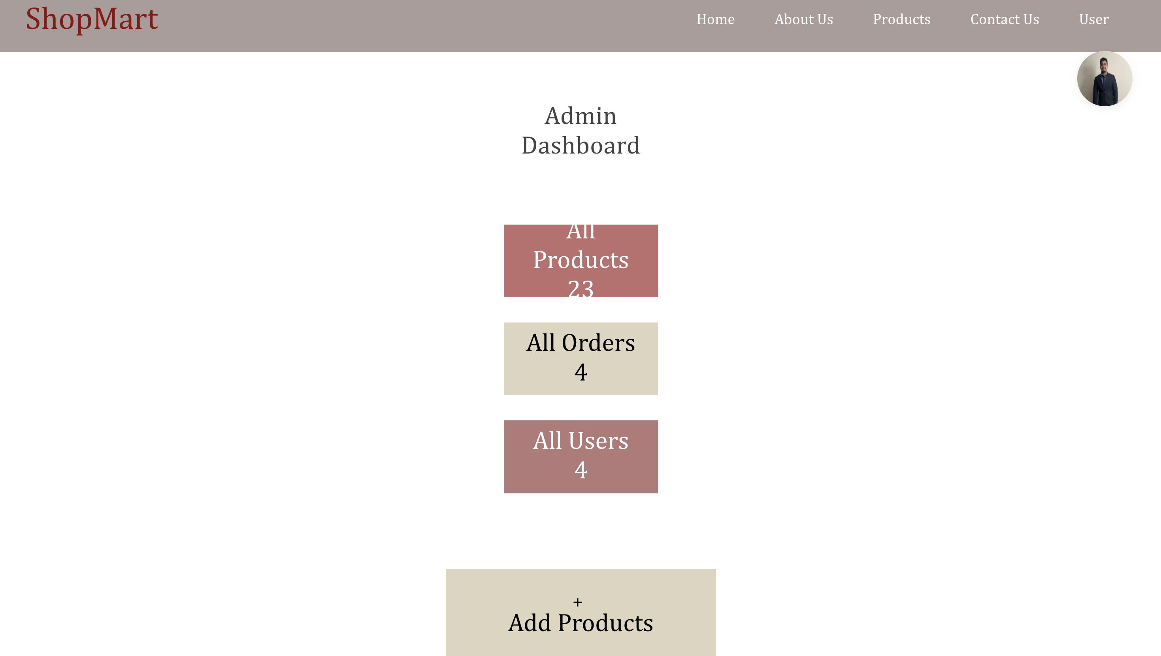
Admin Dashboard Page

Slide 22
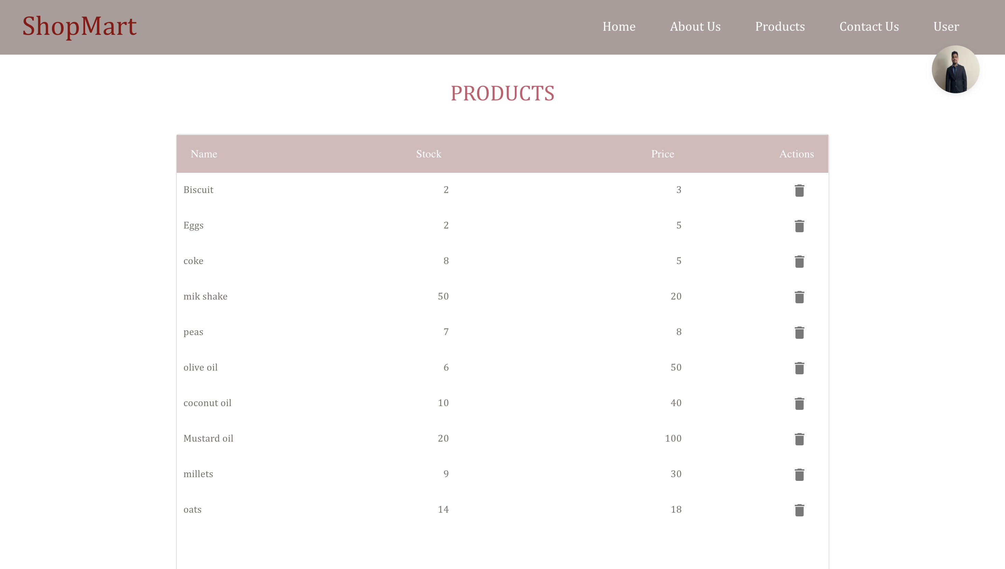
View Products Page (Admin)

Slide 23
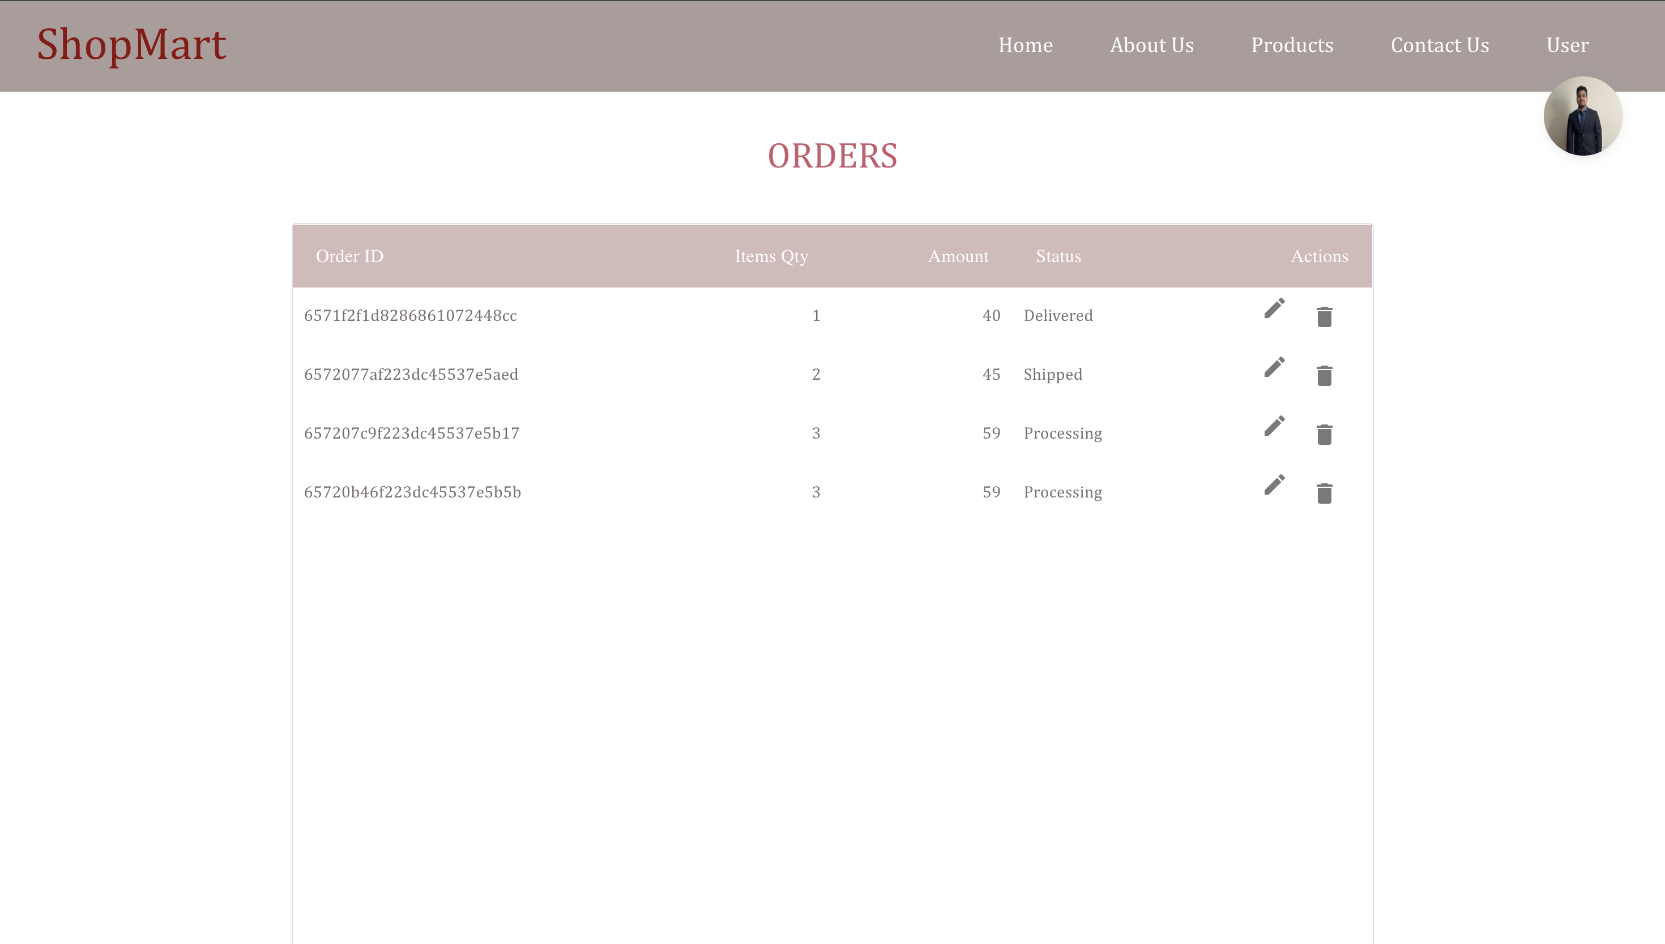
View/Update Orders Page (Admin)

Slide 24
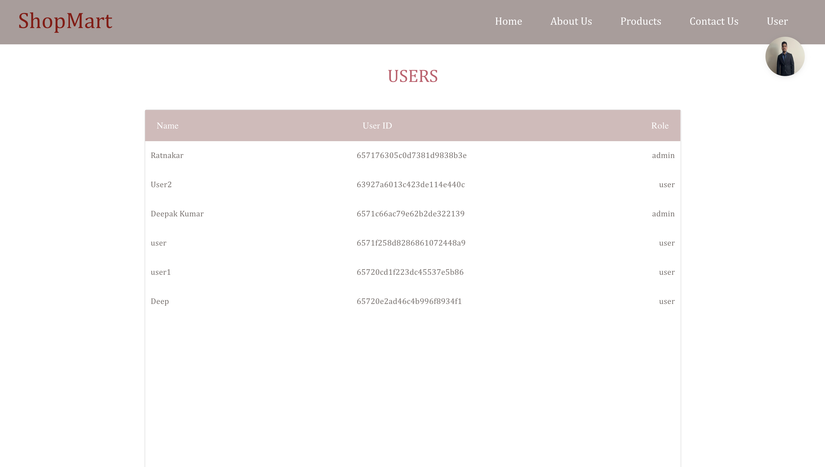
View Users Page (Admin)

Slide 25
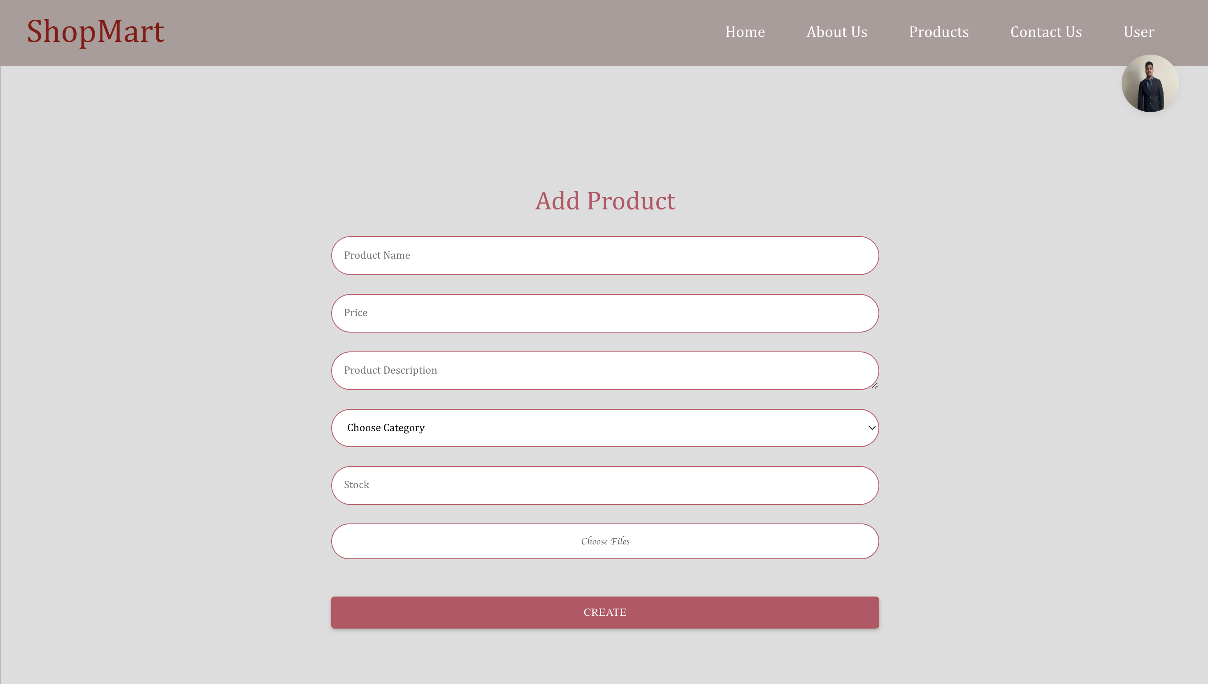
Add Product (Admin)

Slide 26
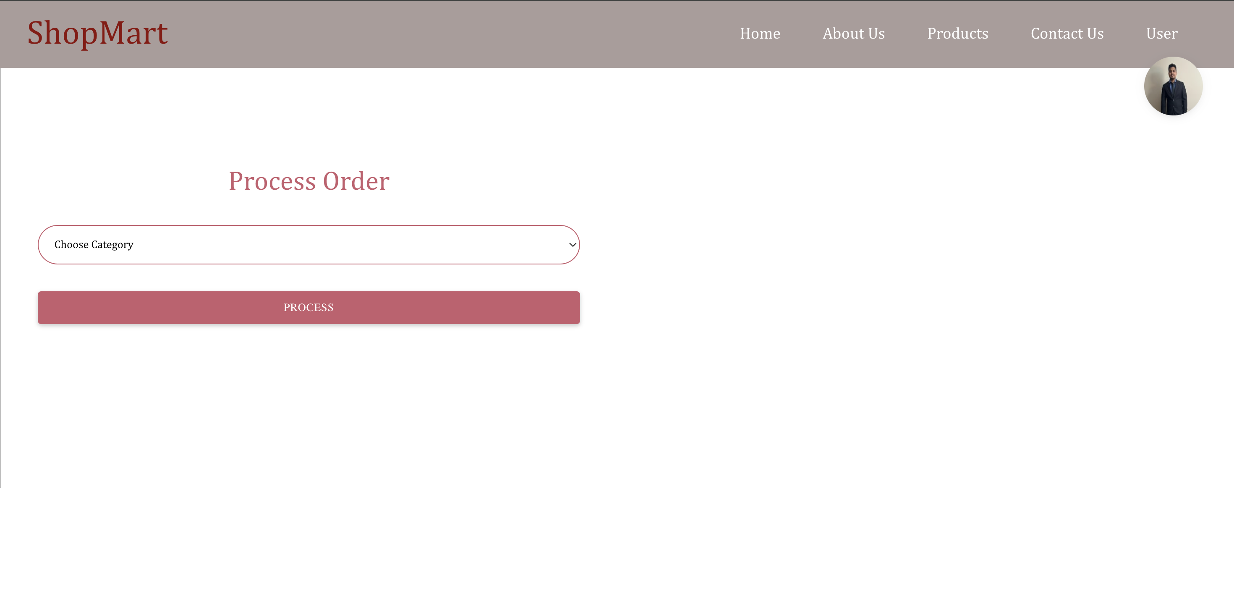
Process Order (Admin)

Slide 27


